Slide 1
At Frist Take My Salam .
Good Evening Sir .

Slide 2

Green University Of Bangladesh
Submitted Form : MD Dulal Hossain ID: 213902116 Section : 213 DA Dept. of CSE,GUB
Submitted To :
Md. Rasel Kabir
Assistant Professor
Applied Linguistics and English Language Teaching

Slide 3
Topic : What would I do if I won 1 Million Dollar.
Outline :
Social Impact
For Myself
My Family
Save for Future Life

Slide 4
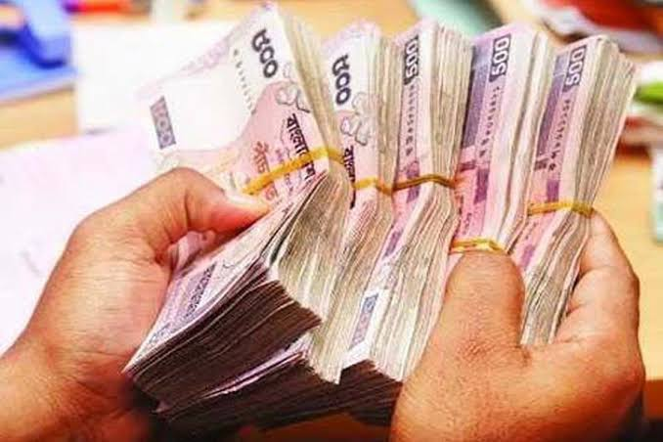
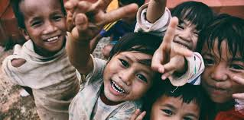
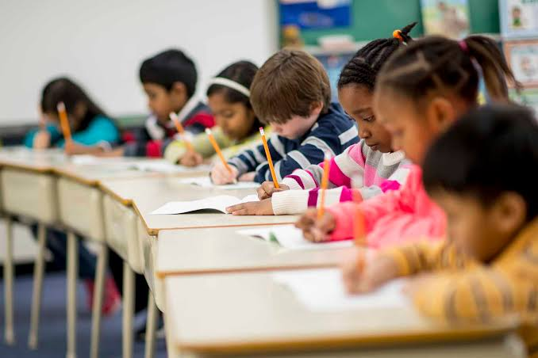
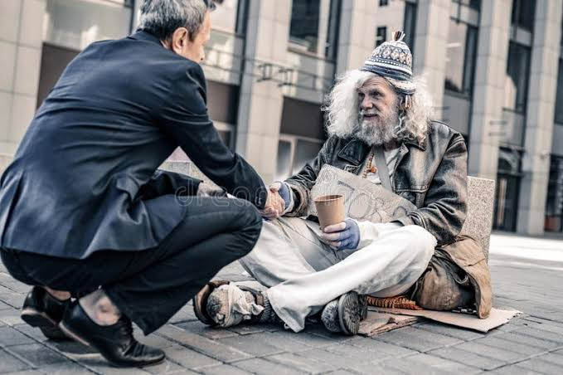
Social Impact
Donate some money
in Masjid
Make a Orphans
Make a School
Help the Poor man

Slide 5
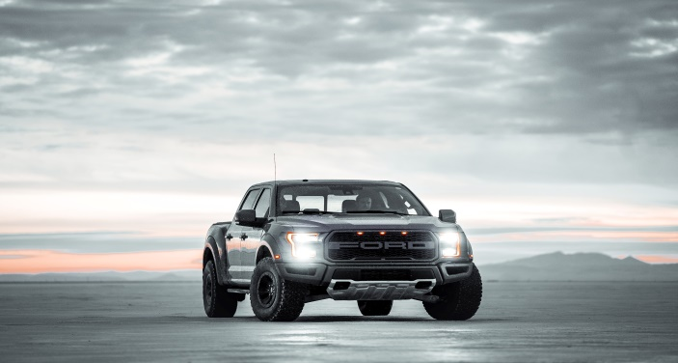
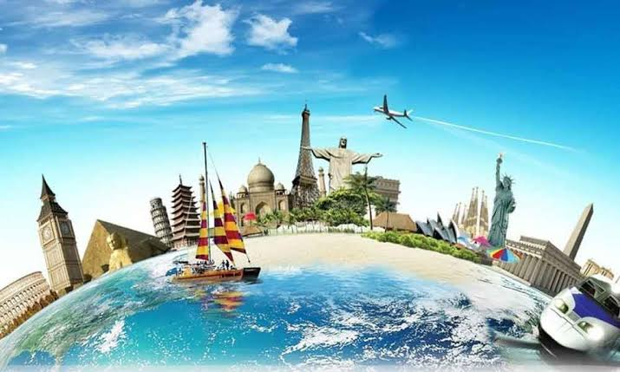
My self
Complete My University
Payment
Buy a new Car
Go world tour

Slide 6

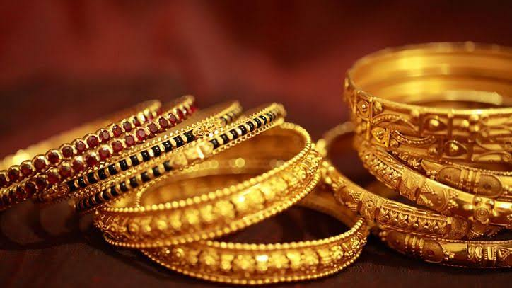
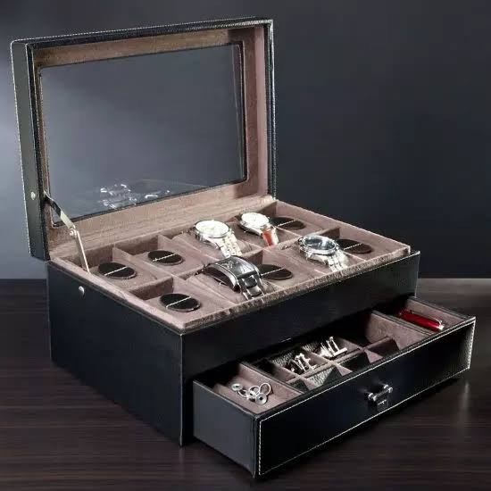
My Family
Buy a New House
Buy jewelry for my Mom
Buy Expensive Gift for my
other family member

Slide 7
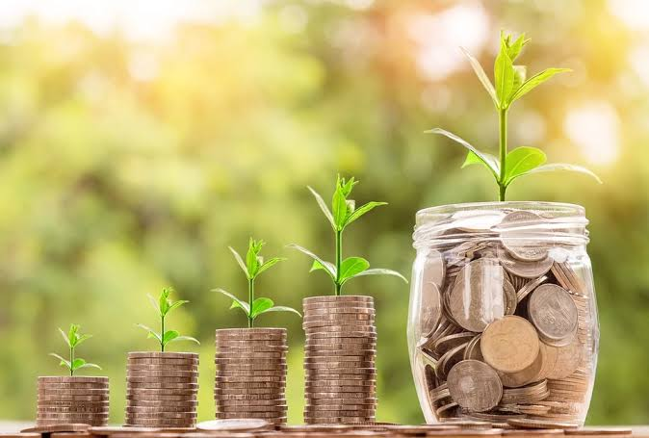


Save for Future Life
Some money for savings
Invest on Share-market
Start-up a new Business

Slide 8
Are there any question ?

Slide 9
Thank You So Much Sir.

